Slide 1
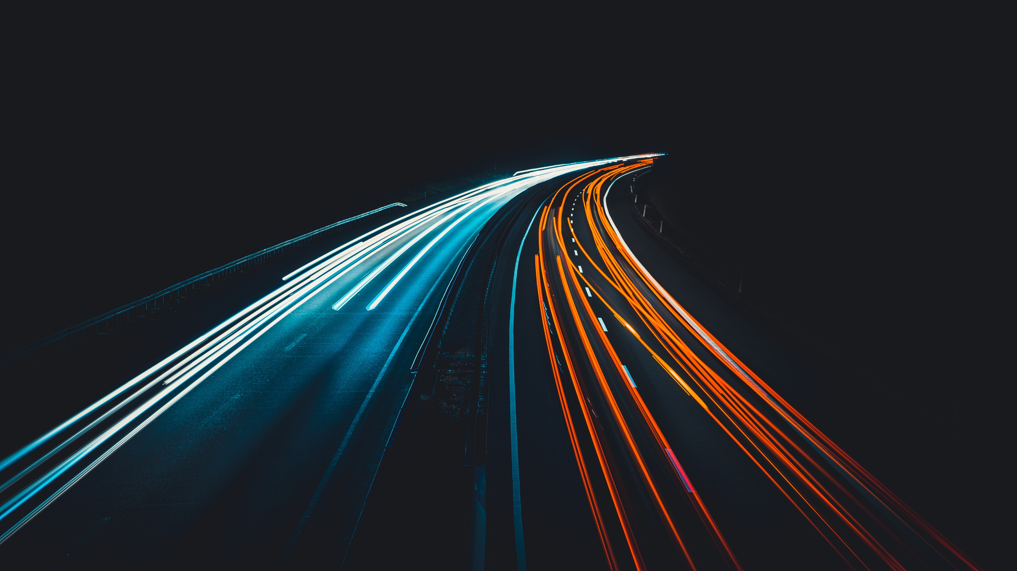
2021S AML 3104 - NEURAL NETWORKS AND DEEP LEARNING
TRAFFIC SIGN CLASSIFICATION
Presented by: Team Rocket
Ajay Dahiya
Akshita Khatri
Angelica Serrano
Jonatas Aguiar
Kuldeep Singh
Faculty Supervisor: Mohammad Islam
Lambton College – Toronto 2021

Slide 2
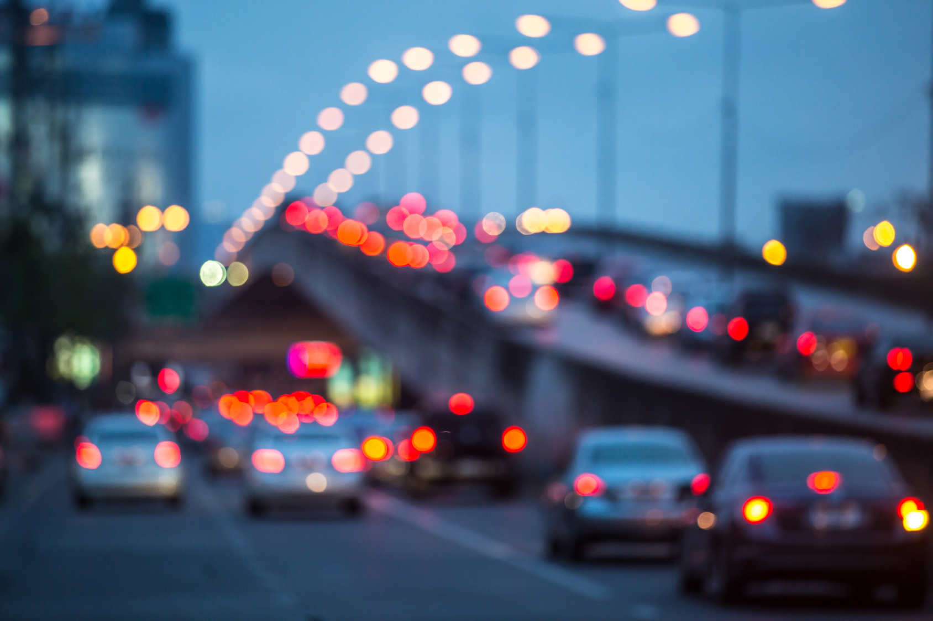
PROBLEM STATEMENT
Image source: https://focus.masseyeandear.org/7-tips-for-seeing-clearly-while-driving-at-night/
Notes:
Road safety is one of the priorities in the Canadian transport system. For several years now, applications dealing with driver assistance, traffic detection, traffic sign classification and smart cars have become an important topic that Machine Learning researchers have been putting immense work on.
Their research has led to the creation of brilliant systems using deep learning.
Deep learning works by training a model to imitate human actions and thinking. One of the applications of deep learning is to solve an image classification problem using CNN.
Traffic sign classification is one example of an image classification use case. With deep learning, an application that can accurately recognize and identify common traffic signs along the road is now possible.
Devices that may act as driver alert systems can generally assist drivers with poor eyesight, such as those with Myopia or nearsightedness.
More often, this condition leads to driving mistakes, road violations and accidents.
It would also be valuable to have a proactive system in our cars as this may serve as additional security while drivers are focusing on the wheels.

Slide 3

GOAL: TRAFFIC SIGN CLASSIFICATION SYSTEM
Notes:
The main goal of this project is to build a Traffic Sign classification system using a Convolutional Neural Network model.
Tensorflow, Keras and Pytorch will be utilized for training a model using a preprocessed dataset.
A web application will be created on top of the CNN model to execute it on the back end and return the interpreted output in high level format.
Additionally, like any driver alert system - a speech generator will be embedded in the system to utter the predicted traffic sign.
Lastly, the application has to be well structured so any future changes can be implemented easily

Slide 4
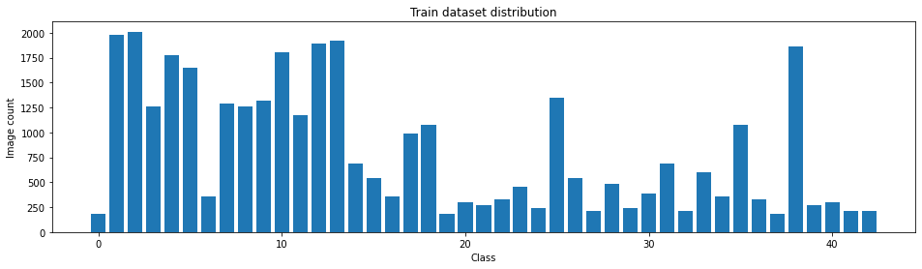
DATASET
01
GTSRB (German Traffic Sign Recognition Benchmark) dataset which originated from INI Benchmark website.
02
50, 839 test and train images.
43 classes.
03
Imbalanced dataset with higher image counts on certain classes.
Class 3 has the highest image count
Class 0 has the lowest image count.

Slide 5
DATA PREPROCESSING
Normalization
OpenCV
Image Data Generator
AUGLY

Slide 6
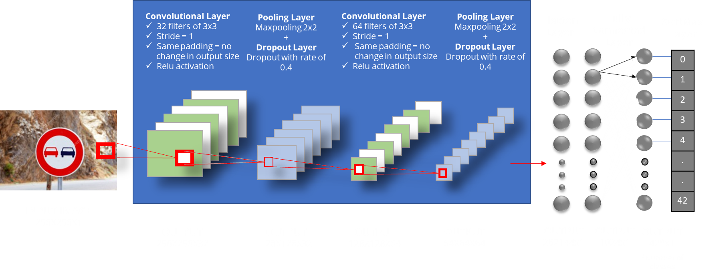
CNN MODEL – METHOD 1 (KERAS)

Slide 7
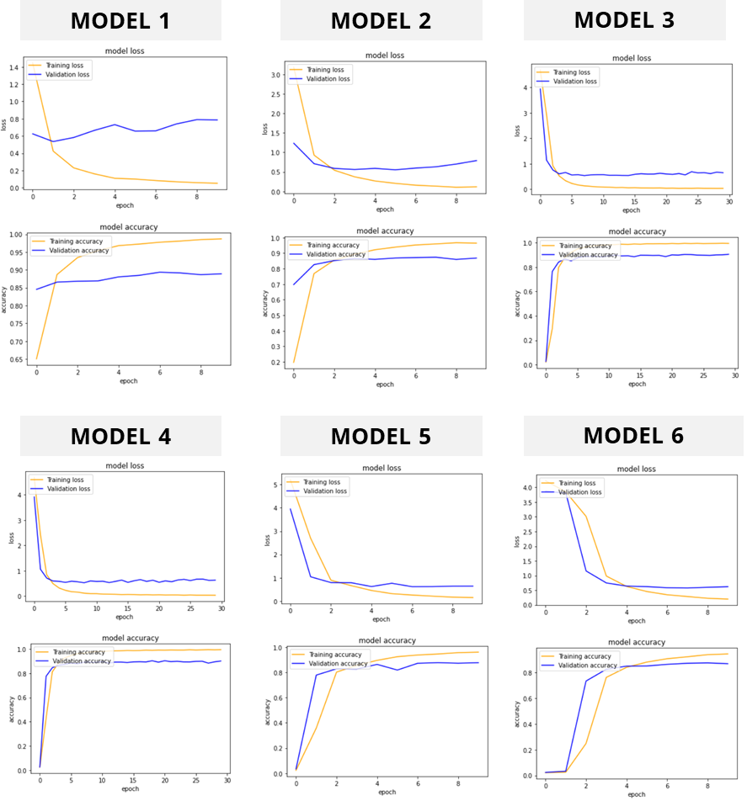

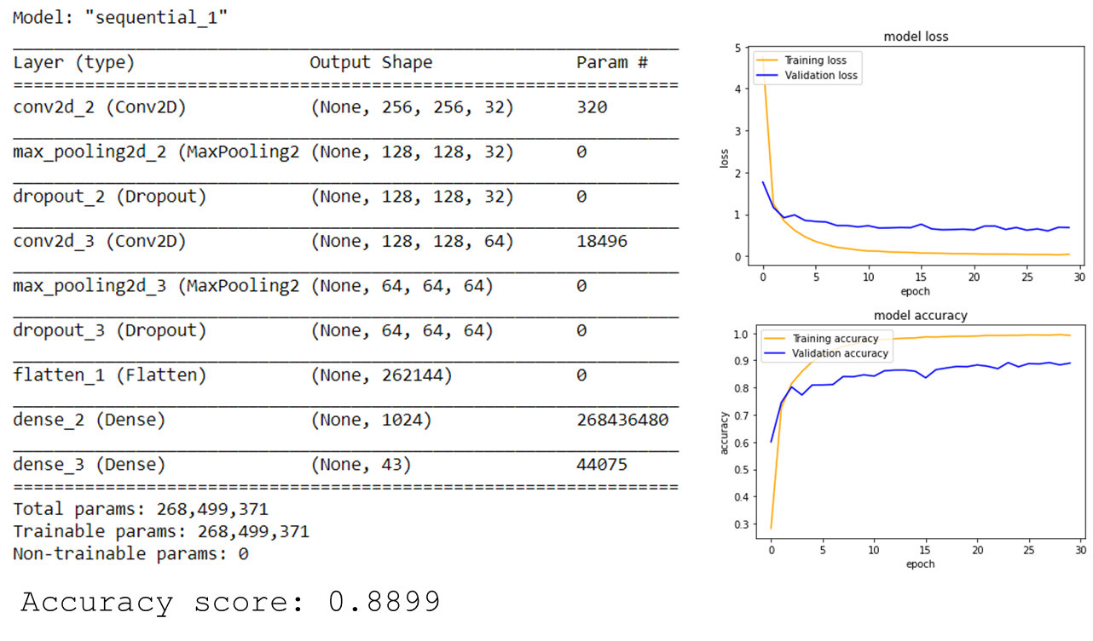
CNN MODEL – METHOD 1 (KERAS)
OVERFITTING REDUCTION TECHNIQUE

Slide 8
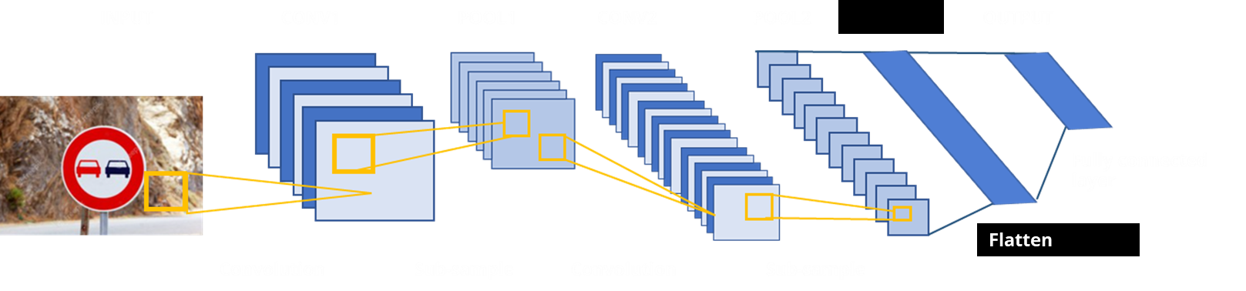
CNN MODEL – METHOD 2 (KERAS)
2
Classic LeNet 5 model architecture

Slide 9
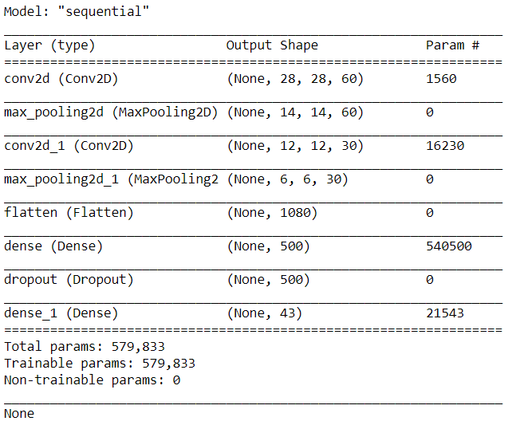
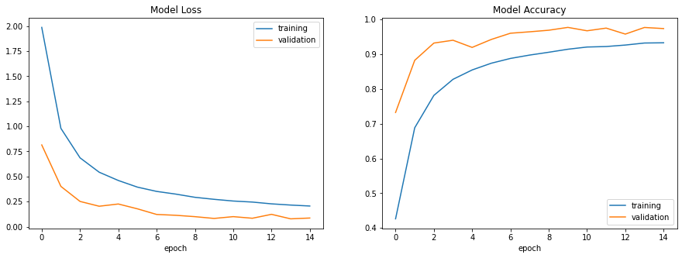

CNN MODEL – METHOD 2 (KERAS)
OVERFITTING REDUCTION
TECHNIQUE
This model adopted the classic LeNet architecture + dropout to reduce overfitting.
2
Classic LeNet 5 model architecture
Notes:
Similar libraries and API were used in this approach. But pre-processing and model training were handled differently.
Data augmentation on 32x32x3 input images were achieved using Keras Image Data Generator
And the generated flow data were fed into the model directly during training phase.
This model adopted LeNet 5 architecture, a classic model proposed by Yann LeCun et al. in 1989.
The model consist two sets of convolutional, activation (ReLU) and pooling layers;
Followed by a fully connected layer, activation, another fully connected, and lastly – a SoftMax layer.
This model is simple, easy to understand and enough to provide good result.
To reduce overfitting, a dropout layer with rate of 0.5 was added to the sequential model.

Slide 10
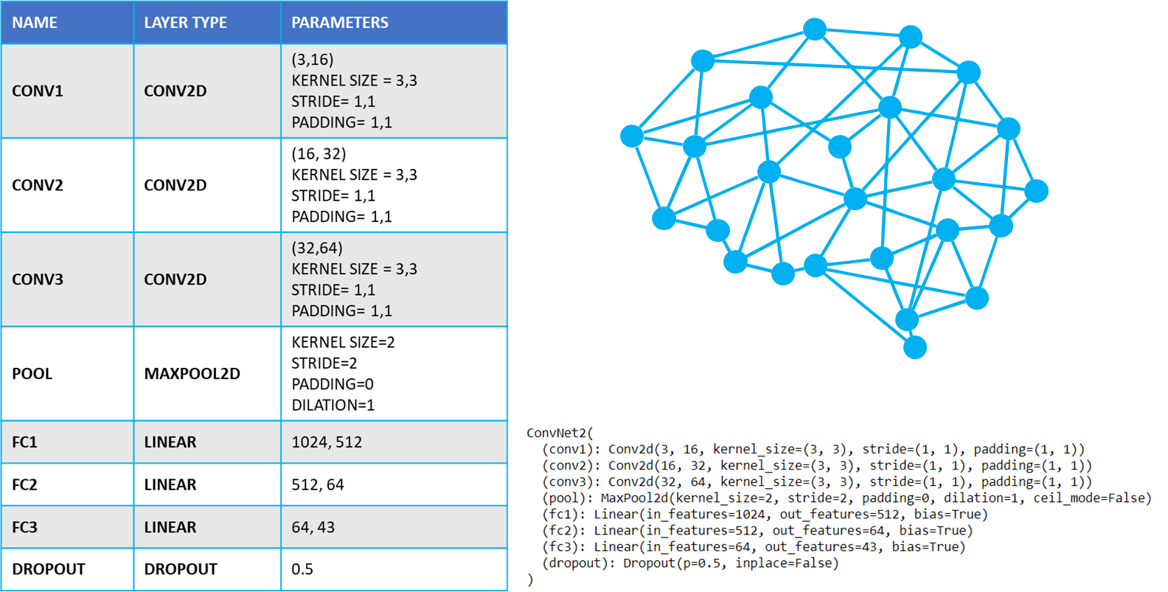
CNN MODEL – METHOD 3

Slide 11
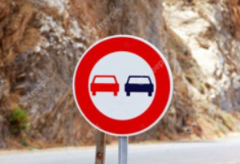
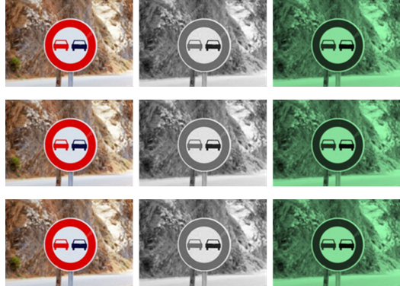
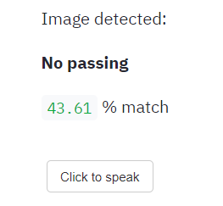
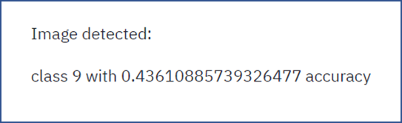
USER INTERFACE - WORKFLOW
INPUT IMAGE
1
PRE-PROCESS
2
3
RETURN THE PREDICTED CLASS AND SCORE
RETURN SIGN NAME.
CLICK TO SPEAK
4

Slide 12
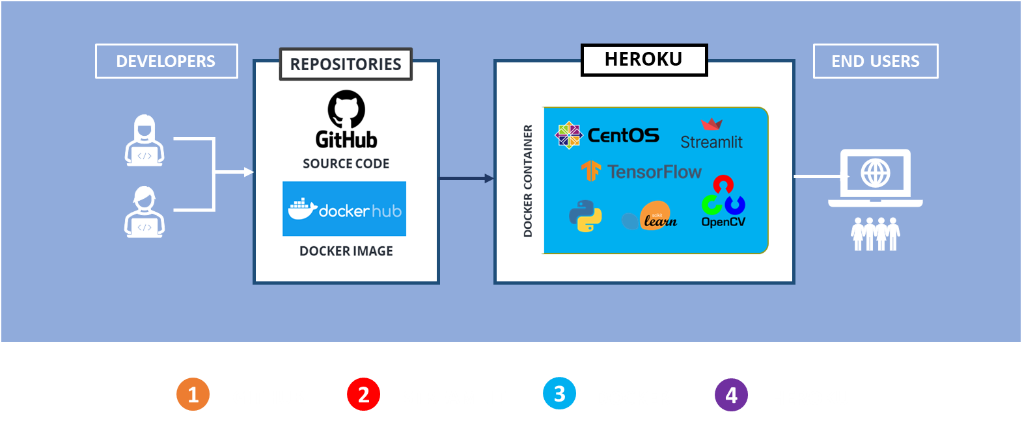
DEPLOYMENT

Slide 13
DEMO

Slide 14

SUMMARY
The project is mainly focused on creating a multi-class classification model that predicts traffic sign using CNN.
Experiment concluded to use Method 2 (LeNet model) as the final one. It generated lower loss and 94% val accuracy.
GTSRB dataset was used as training data. Various pre-processing techniques were performed.
Streamlit was used to build the UI. The whole set-up was compiled in a docker image and deployed to Heroku cloud service.
Three methods were conducted to generate the best model. Two methods used Keras sequential API and the other one used Pytorch.
It was realized that a good quality model can be achieved, not only by data preprocessing and model tuning but mostly by having adequate and balanced dataset.

Slide 15

THANK YOU!
Any questions?

